Slide 1
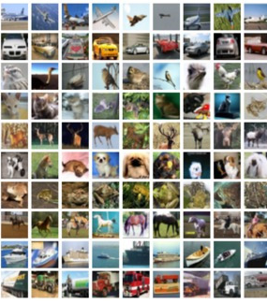
BUILDING AN MLP FOR IMAGE CLASSIFICATION
DATASET: CIFAR 10
- Shravanthi Sridhar

Slide 2
EXAMPLES OF SOME OF THE PARAMETERS TUNING SETTINGS AND OBSERVATIONS

Slide 3
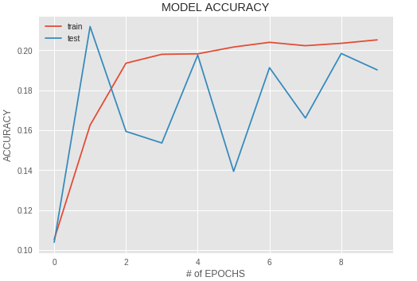
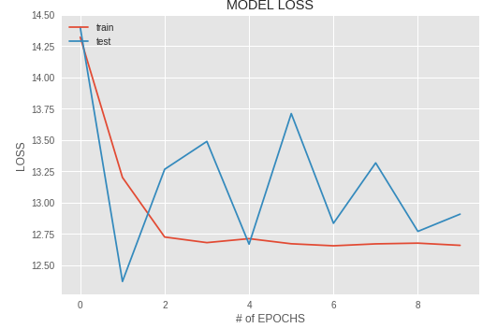
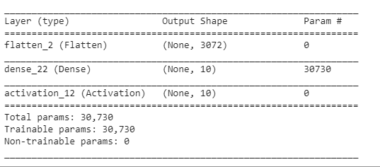
Initial Setting: Similar to logistic regression
Epoch 10
No of layers: 1
Batch size 32
Learning rate = 0.01

Slide 4
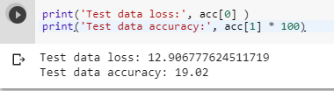
PERFORMANCE:
Model performance is bad when logistic regression is applied.
Accuracy is very low and Loss is very high.

Slide 5
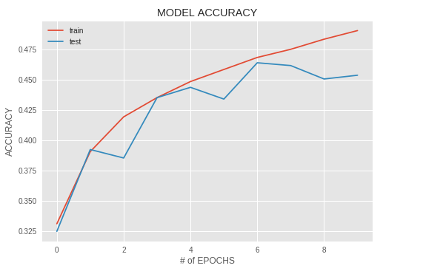
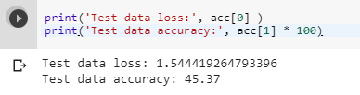
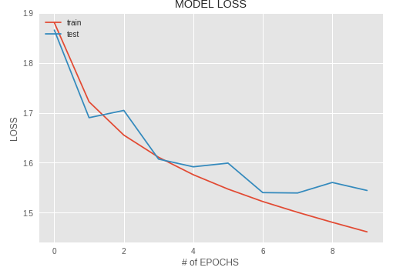
EFFECT OF ACTIVATION FUNCTIONS
Activation function: tanh
Learning Rate: 0.0001
Batch size: 32
No of neurons: 128

Slide 6
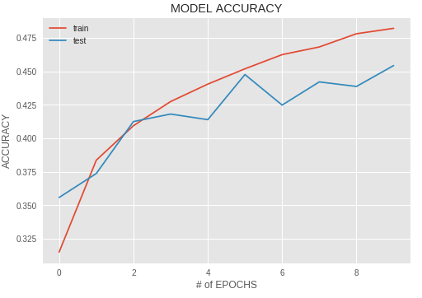
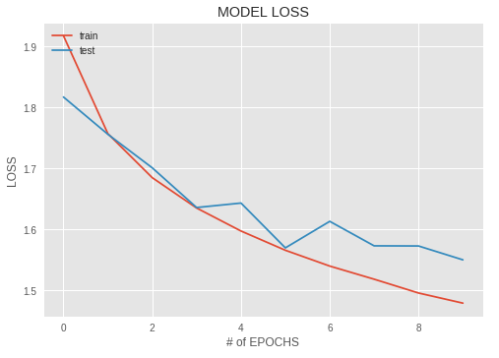
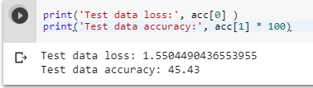
Activation function: relu
Learning rate: 0.0001
Batch size: 32
Neurons: 128

Slide 7
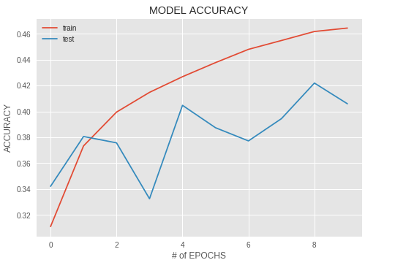
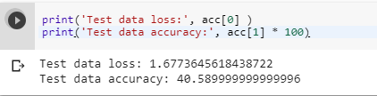
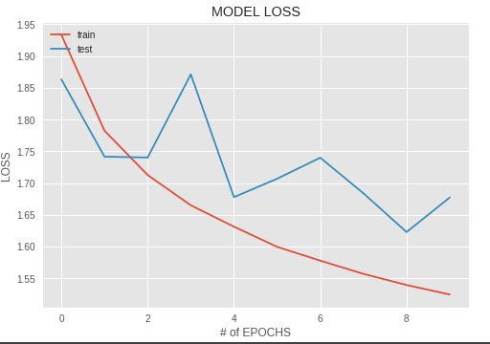
Activation function: selu

Slide 8
RESULTS
It is observed that activation function relu gives the best performance on model compared to others
NOTE:
List of activation functions used along with parameter settings is attached in the excel sheet

Slide 9
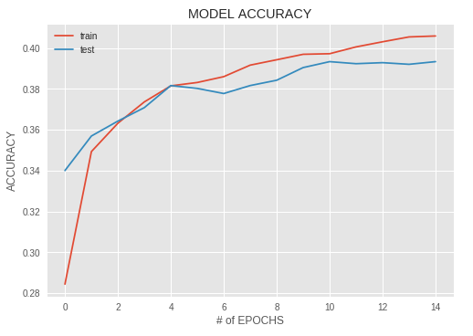

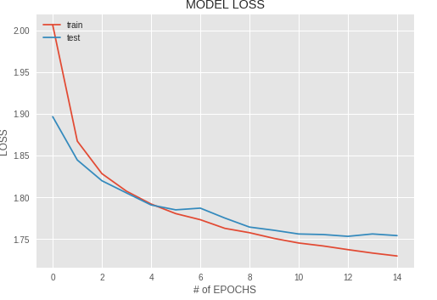
EFFECT OF NUMBER OF LAYERS
No of layers : 1

Slide 10
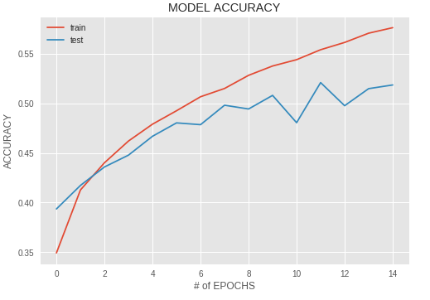
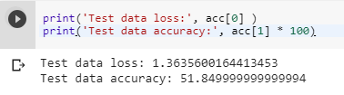
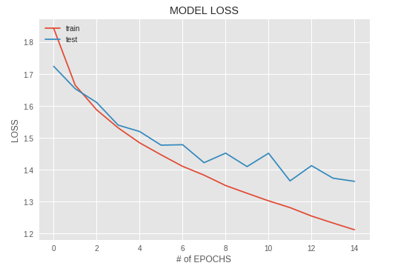
No of layers: 2

Slide 11
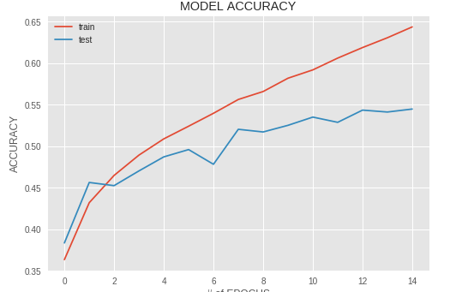
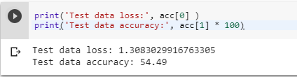
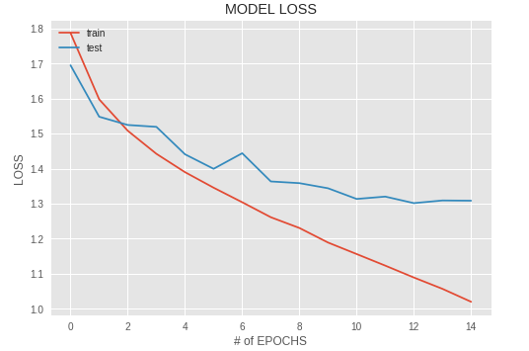
3 layers:

Slide 12
Final Observations
Model performance increases with increase in number of layers
There is only a minimal difference with training time since the model layer is incremented by 1 every time
Increasing model layer by a small amount every iteration could give a clear idea of the performance and training time as well

Slide 13
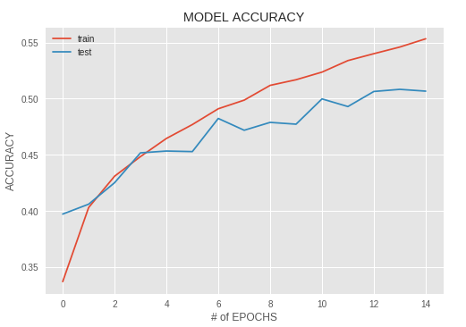
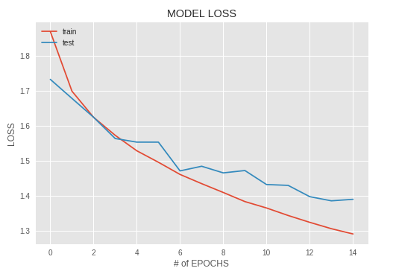
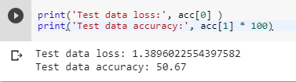
EFFECT OF NUMBER OF NEURONS
No of neurons: 512

Slide 14
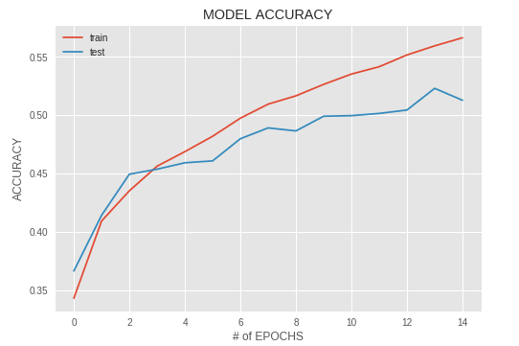

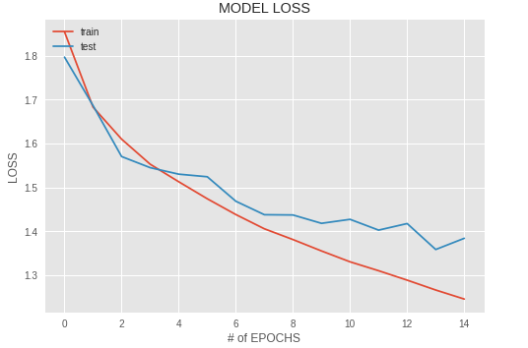
No of neurons: 1024

Slide 15
No of neurons: 2048

Slide 16
Final Observations:
With the increase in number of neurons in a layer, model performance seems to increase
Model Accuracy increases and Model Loss decreases
However, one has to be careful in choosing which layers to increase the number of neurons. In some cases, model performance might decrease while increasing neurons in one layer and not in the others. One has to go for trail and error to figure out the underlying model performance on the given problem

Slide 17
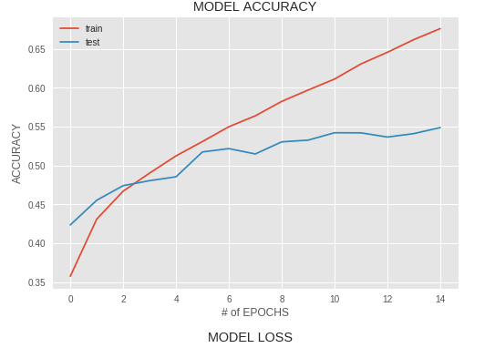
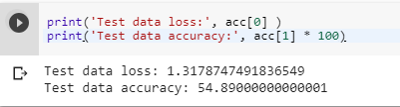
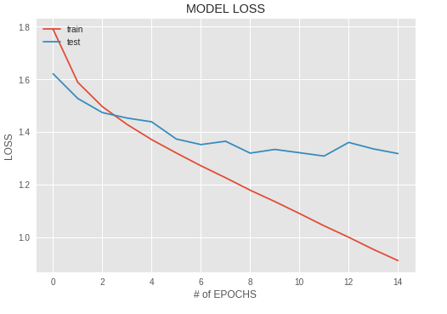
Effect of batch size
Initial batch size: 32

Slide 18
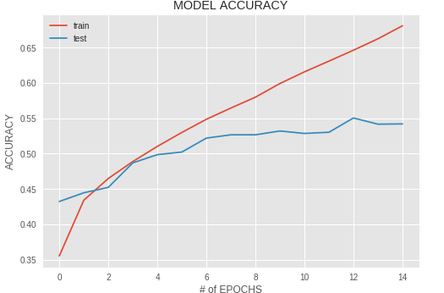
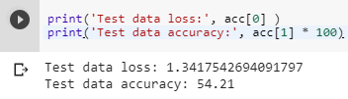
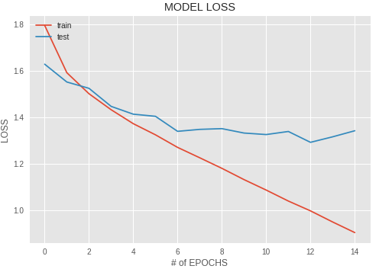
Batch Size: 64

Slide 19
Final Results:
Model Performance seems to decrease with increase in batch size
This is not the case always, hence one has to be careful while choosing batch size to keep track of performance and training time of model

Slide 20
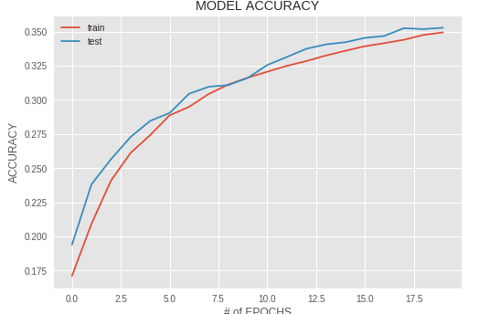
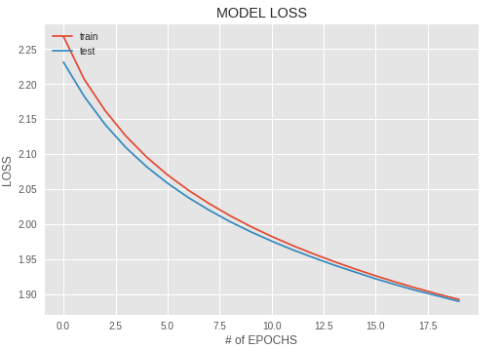
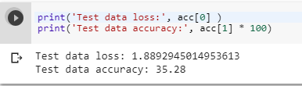
EFFECT OF OPTIMIZERS ON MODEL PERFORMANCE:
Stochastic Gradient Descent

Slide 21
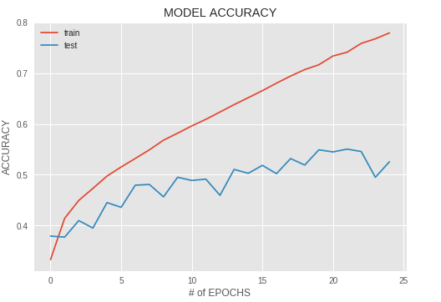
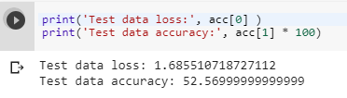
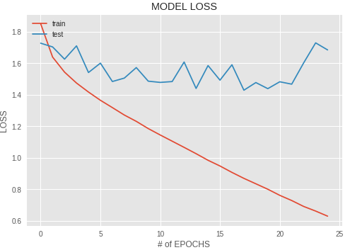
RmsProp

Slide 22
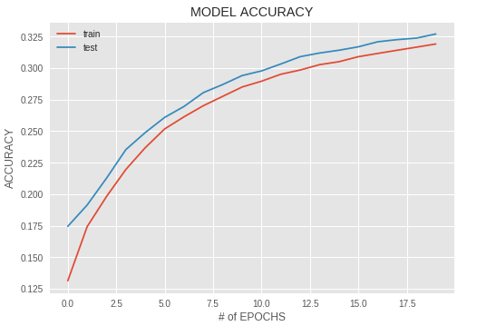

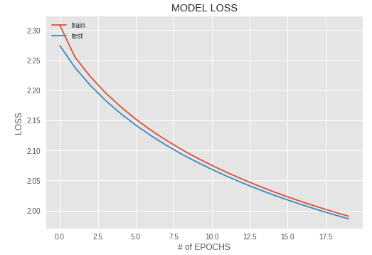
Adadelta

Slide 23
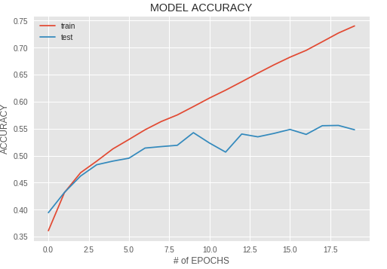
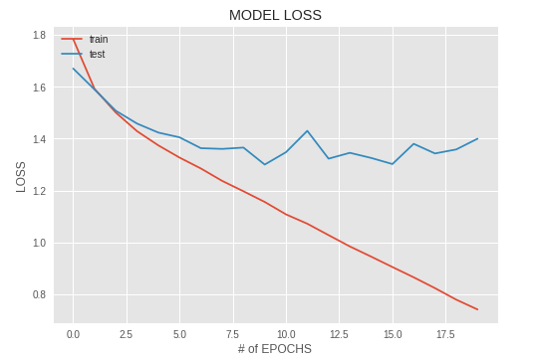
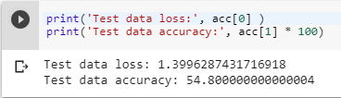
Optimizer: Adam
Epoch 20
Lr .0001
No of neurons, double in each layer
No of layers: 3
Batch size 64

Slide 24
RESULT
OPTIMIZER | PERFORMANCE | POSSIBLE REASONS
SGD | SGD Performance was bad on test data | Loss function may have local minima or saddle point sue to which there could be zero gradient Since gradient comes from minibatches, it could be noisy
AdaDelta | Performs better than SGD, but not very good on test data | Might have got stuck approaching saddle points in data which will no longer allow to progress
RmsProp | Performs better than SGD and AdaDelta | Performed better as it takes squared estimates of gradients Similar to momentum over squared gradients
Adam | Performs best for this model | It has the advantage of RmsProp and Momentum Additionally, Bias term is also used to increase the gradient performance

Slide 25
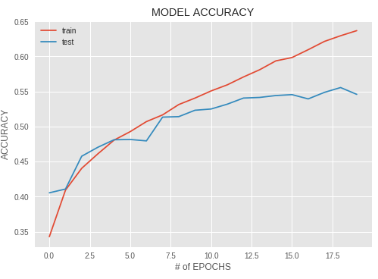
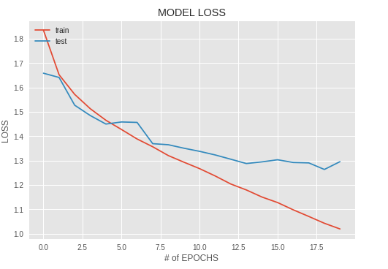

Dropout: Prevents overfitting
Model Loss seems to decrease with dropout rates

Slide 26
FINAL MODEL RECOMMENDATION
Hyperparameters Settings:
Number of epochs: 20
Batch size: 64
No of neurons: double in each layer(512,1024,2048)
Activation function used: relu
Optimizer used: Adam
Learning Rate: 0.0001
Drop out rate: 20%

Slide 27
MODEL PERFORMANCE
Why this model?
A Multi Layer Perceptron with the following parameter settings and a GPU hardware seems to train at much faster pace providing High Accuracy and Low Loss. Also, it seems to avoid the problem of overfitting up to a great extent.
One more important setting to be looked upon is the hardware settings. It makes a great difference to use GPU over CPU saving a lot of time.
CPU | GPU
Model Training and Validation Time: 51 mins | Model Training and Validation Time: 5 mins

Slide 28
IMPROVEMENTS TO BE DONE
For an MLP, nothing more can be done to improve the model accuracy.
I believe the recommended model would suffice in providing a good performance in less time.
Moving to a Convolution neural network could help improve the model performance.
Multiple convolution layers and filters can be added to model accordingly to see the improvement in performance.

Slide 29
COMPARISON OF MLP AND CNN
METRIC | MLP | CNN
MODEL ACCURACY | 54.98% | 80.95%
MODEL LOSS | 1.2 | .76
TRAINING TIME | GPU: 5 mins CPU: 51 mins | GPU: 11 mins CPU: 330 mins
NUMBER OF LAYERS | 4 | 12
NUMBER OF EPOCHS | 20 | 25
REGULARIZATIONS USED | Dropout | Dropout, Batch Normalization
Link to GitHub Code | https://github.com/Shravsridhar/MLP--CIFAR10/blob/master/mlp_cifar10.ipynb | https://github.com/Shravsridhar/CNN_CIFAR10/blob/master/cnn_cifar10%20(1).ipynb

Slide 30
FUTURE WORKS
Implementation of other Regularizations like Data Augmentation to improve model performance
Implementation of Transfer Learning which uses pretrained networks could improve model performance to a great extent
One of example model: Inception V3
Implementation of Ensemble methods where several models are created and combined to produce improved classification results

